Slide 1
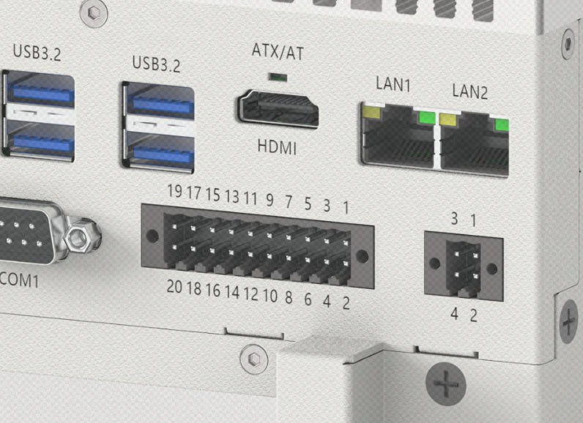
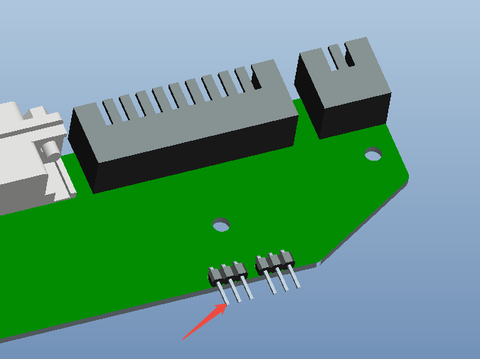
Specification of 16-Channel GPIO with 3.3V Direct Output from the Motherboard
Pin Definitions
19 | 17 | 15 | 13 | 11 | 9 | 7 | 5 | 3 | 1
GPIO12 | GPIO11 | GPIO10 | GPIO9 | GPIO4 | GPIO3 | GPIO2 | GPIO1 | GND | V5S
20 | 18 | 16 | 14 | 12 | 10 | 8 | 6 | 4 | 2
GPIO16 | GPIO15 | GPIO14 | GPIO13 | GPIO8 | GPIO7 | GPIO6 | GPIO5 | GND | DC_OUT
Panel Connector Pin 2 (DC_OUT) – Jumper Definition, Silkscreen: JDC_OUT1
1-2 | DC_OUT * NC | By default, Pin 2 (DC_OUT) is unpowered
2-3 | DC_OUT * DC_IN | Pin 2 is shorted to the system’s input power.
Description: When external devices require power, Pin 2 can be enabled to output voltage. It should be used together with Pin 4 (GND) to supply power to the external device. The output voltage on Pin 2 will match the system’s input voltage.

Slide 2
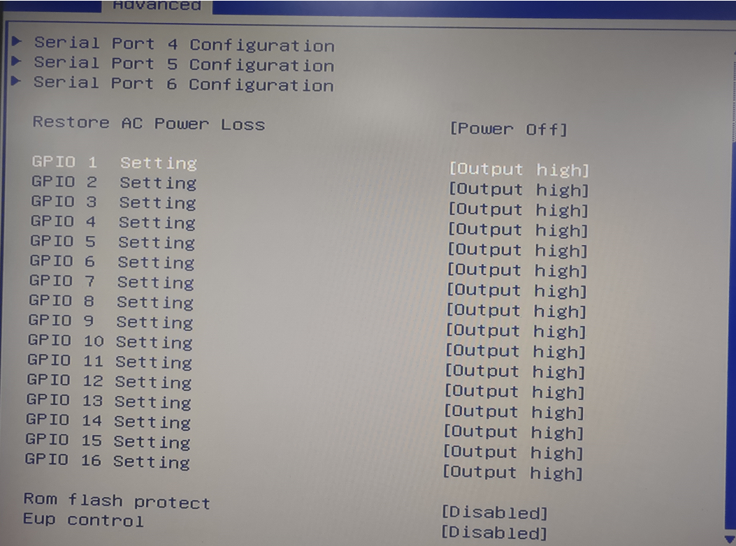
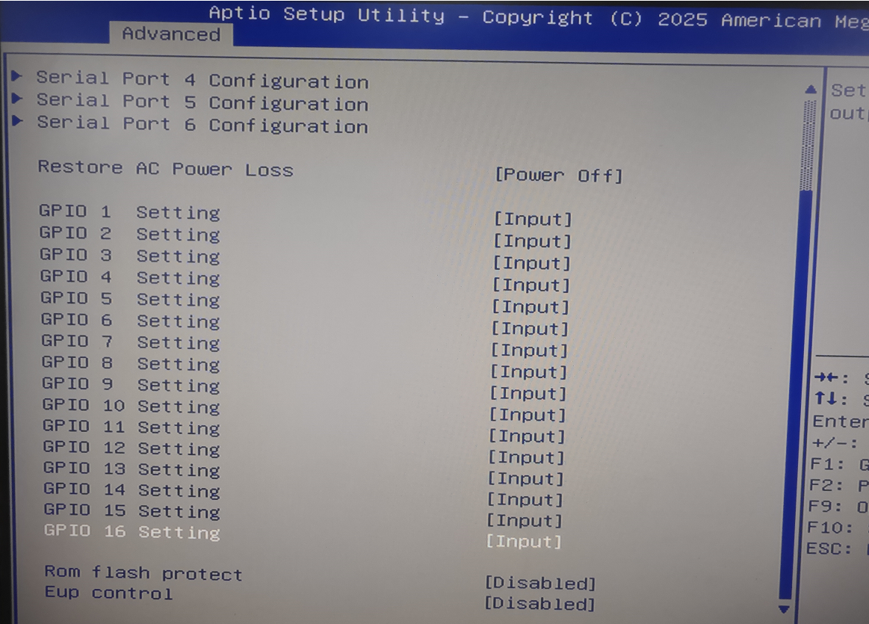
GPIO1–16 are set to DO (Digital Output) mode by default. In the BIOS, the output state can be configured as HIGH or LOW.
Each GPIO can be configured as DI (Digital Input) mode through the BIOS.

Slide 3
GPIO地址
Function | Default State / Options | Description | Address
GPIO1 | HIGH/LOW | BIOS Options | A06
GPIO2 | HIGH/LOW | BIOS Options
GPIO3 | HIGH/LOW | BIOS Options
GPIO4 | HIGH/LOW | BIOS Options
GPIO5 | HIGH/LOW | BIOS Options
GPIO6 | HIGH/LOW | BIOS Options
GPIO7 | HIGH/LOW | BIOS Options
GPIO8 | HIGH/LOW | BIOS Options
GPIO9 | HIGH/LOW | BIOS Options | A07
GPIO10 | HIGH/LOW | BIOS Options
GPIO11 | HIGH/LOW | BIOS Options
GPIO12 | HIGH/LOW | BIOS Options
GPIO13 | HIGH/LOW | BIOS Options
GPIO14 | HIGH/LOW | BIOS Options
GPIO15 | HIGH/LOW | BIOS Options
GPIO16 | HIGH/LOW | BIOS Options
When the GPIOs are in DO (Digital Output) mode:
Writing a hexadecimal value to address A06 controls the HIGH/LOW states of GPIO1–8.
Writing a hexadecimal value to address A07 controls the HIGH/LOW states of GPIO9–16.

Slide 4
Method to Obtain the Hexadecimal Value
 | GPIO8 | GPIO7 | GPIO6 | GPIO5 | GPIO4 | GPIO3 | GPIO2 | GPIO1
Example 1 | 0 | 0 | 0 | 0 | 0 | 0 | 0 | 0
Description: All GPIO1–8 values are 0, which represents a LOW state for each GPIO. The corresponding binary value is 00000000, which converts to the hexadecimal value 0x00.
 | GPIO8 | GPIO7 | GPIO6 | GPIO5 | GPIO4 | GPIO3 | GPIO2 | GPIO1
Example 2 | 0 | 0 | 0 | 0 | 0 | 0 | 1 | 0
Description: GPIO2 is set to 1 while all other GPIOs are 0, indicating that GPIO2 is HIGH and all others are LOW. The corresponding binary value is 00000010, which converts to the hexadecimal value 0x02.
 | GPIO8 | GPIO7 | GPIO6 | GPIO5 | GPIO4 | GPIO3 | GPIO2 | GPIO1
Example 3 | 0 | 0 | 0 | 0 | 1 | 0 | 1 | 0
Description: GPIO2 and GPIO4 are set to 1, while all other GPIOs are 0, indicating that GPIO2 and GPIO4 are HIGH and all others are LOW. The corresponding binary value is 00001010, which converts to the hexadecimal value 0x0A.
 | GPIO8 | GPIO7 | GPIO6 | GPIO5 | GPIO4 | GPIO3 | GPIO2 | GPIO1
Example 4 | 0 | 1 | 1 | 0 | 0 | 1 | 0 | 0
Description: GPIO3, GPIO6, and GPIO7 are set to 1, while all other GPIOs are 0, indicating that GPIO3, GPIO6, and GPIO7 are HIGH and all others are LOW. The corresponding binary value is 01100100, which converts to the hexadecimal value 0x64.
Writing the obtained hexadecimal value to address A06 sets the corresponding HIGH/LOW states for GPIO1–8. Similarly, writing the obtained hexadecimal value to address A07 sets the corresponding HIGH/LOW states for GPIO9–16.
 | GPIO16 | GPIO15 | GPIO14 | GPIO13 | GPIO12 | GPIO11 | GPIO10 | GPIO9
Example 1 | 0 | 0 | 0 | 0 | 0 | 0 | 0 | 0
Description: All GPIO9–16 values are 0, indicating that all corresponding GPIOs are in the LOW state. The corresponding binary value is 00000000, which converts to the hexadecimal value 0x00.
 | GPIO16 | GPIO15 | GPIO14 | GPIO13 | GPIO12 | GPIO11 | GPIO10 | GPIO9
Example 2 | 0 | 0 | 0 | 0 | 0 | 0 | 1 | 0
Description: GPIO10 is set to 1, while all other GPIOs are 0, indicating that GPIO10 is HIGH and all others are LOW. The corresponding binary value is 00000010, which converts to the hexadecimal value 0x02.
 | GPIO16 | GPIO15 | GPIO14 | GPIO13 | GPIO12 | GPIO11 | GPIO10 | GPIO9
Example 3 | 0 | 0 | 0 | 0 | 1 | 0 | 1 | 0
Description: GPIO10 and GPIO12 are set to 1, while all other GPIOs are 0, indicating that GPIO10 and GPIO12 are HIGH and all others are LOW. The corresponding binary value is 00001010, which converts to the hexadecimal value 0x0A.
 | GPIO16 | GPIO15 | GPIO14 | GPIO13 | GPIO12 | GPIO11 | GPIO10 | GPIO9
Example 4 | 0 | 1 | 1 | 0 | 0 | 1 | 0 | 0
Description: GPIO11, GPIO14, and GPIO15 are set to 1, while all other GPIOs are 0, indicating that GPIO11, GPIO14, and GPIO15 are HIGH and all others are LOW. The corresponding binary value is 01100100, which converts to the hexadecimal value 0x64.
Note: You can use search engines such as Google to find binary-to-hexadecimal converters for quick conversion.

Slide 5
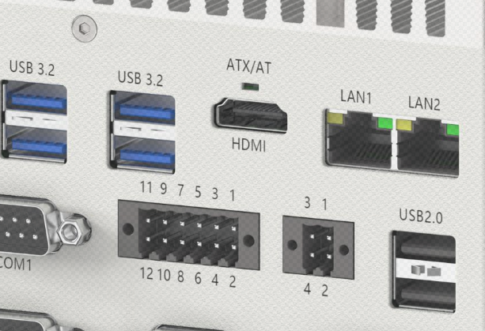
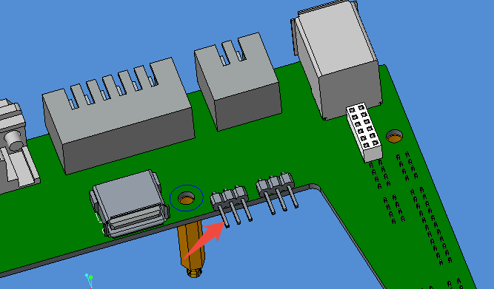
8-Channel 3.3V Direct-Output GPIO Description
Pin Definitions
11 | 9 | 7 | 5 | 3 | 1
GPIO4 | GPIO3 | GPIO2 | GPIO1 | GND | V5S
12 | 10 | 8 | 6 | 4 | 2
GPIO8 | GPIO7 | GPIO6 | GPIO5 | GND | DC_OUT
Panel Connector Pin 2 (DC_OUT) – Jumper Definition, Silkscreen: JDC_OUT1
1-2 | DC_OUT * NC | By default, Pin 2 (DC_OUT) is unpowered.
2-3 | DC_OUT * DC_IN | Pin 2 is shorted to the system’s input power.
Description: When an external device requires power, Pin 2 (DC_OUT) can be enabled and used together with Pin 4 (GND) to supply power to the external device. The output voltage on Pin 2 will match the system’s input voltage.
INDUSTRIAL COMPUTER MANUFACTURER

Slide 6
GPIO1–8 are set to DO (Digital Output) mode by default. In the BIOS, the output state can be configured as HIGH or LOW.
Each GPIO can be configured as DI (Digital Input) mode through the BIOS.

Slide 7
GPIO Address
Function | Default State / Options | Description | Address
GPIO1 | HIGH/LOW | BIOS Options | A06
GPIO2 | HIGH/LOW | BIOS Options
GPIO3 | HIGH/LOW | BIOS Options
GPIO4 | HIGH/LOW | BIOS Options
GPIO5 | HIGH/LOW | BIOS Options
GPIO6 | HIGH/LOW | BIOS Options
GPIO7 | HIGH/LOW | BIOS Options
GPIO8 | HIGH/LOW | BIOS Options
When the GPIOs are in DO (Digital Output) mode: Writing a hexadecimal value to address A06 controls the HIGH/LOW states of GPIO1–8.
Method to Obtain the Hexadecimal Value
 | GPIO8 | GPIO7 | GPIO6 | GPIO5 | GPIO4 | GPIO3 | GPIO2 | GPIO1
Example 1 | 0 | 0 | 0 | 0 | 0 | 0 | 0 | 0
Description: All GPIO1–8 values are 0, indicating that all corresponding GPIOs are in the LOW state. The corresponding binary value is 00000000, which converts to the hexadecimal value 0x00.
 | GPIO8 | GPIO7 | GPIO6 | GPIO5 | GPIO4 | GPIO3 | GPIO2 | GPIO1
Example 2 | 0 | 0 | 0 | 0 | 0 | 0 | 1 | 0
Description: GPIO2 is set to 1, while all other GPIOs are 0, indicating that GPIO2 is HIGH and all others are LOW. The corresponding binary value is 00000010, which converts to the hexadecimal value 0x02.
 | GPIO8 | GPIO7 | GPIO6 | GPIO5 | GPIO4 | GPIO3 | GPIO2 | GPIO1
Example 3 | 0 | 0 | 0 | 0 | 1 | 0 | 1 | 0
Description: GPIO2 and GPIO4 are set to 1, while all other GPIOs are 0, indicating that GPIO2 and GPIO4 are HIGH and all others are LOW. The corresponding binary value is 00001010, which converts to the hexadecimal value 0x0A.
 | GPIO8 | GPIO7 | GPIO6 | GPIO5 | GPIO4 | GPIO3 | GPIO2 | GPIO1
Example 4 | 0 | 1 | 1 | 0 | 0 | 1 | 0 | 0
Description: GPIO3, GPIO6, and GPIO7 are set to 1, while all other GPIOs are 0, indicating that GPIO3, GPIO6, and GPIO7 are HIGH and all others are LOW. The corresponding binary value is 01100100, which converts to the hexadecimal value 0x64.
Writing the obtained hexadecimal value to address A06 will set the corresponding HIGH/LOW states for GPIO1–8.
Note: You can use search engines such as Google to find binary-to-hexadecimal converters for quick conversion.

